Slide 1
CNN Ensemble & Siamese
Presenters: Happy & Grace

Slide 2
Siamese CNN
01

Slide 3
What is a Siamese CNN
02
A Siamese network is a class of neural networks that contains one or more identical networks.
We feed a pair of inputs to these networks. Each network computes the features of one input. And, then the similarity of features is computed using their difference or the dot product.

Slide 4
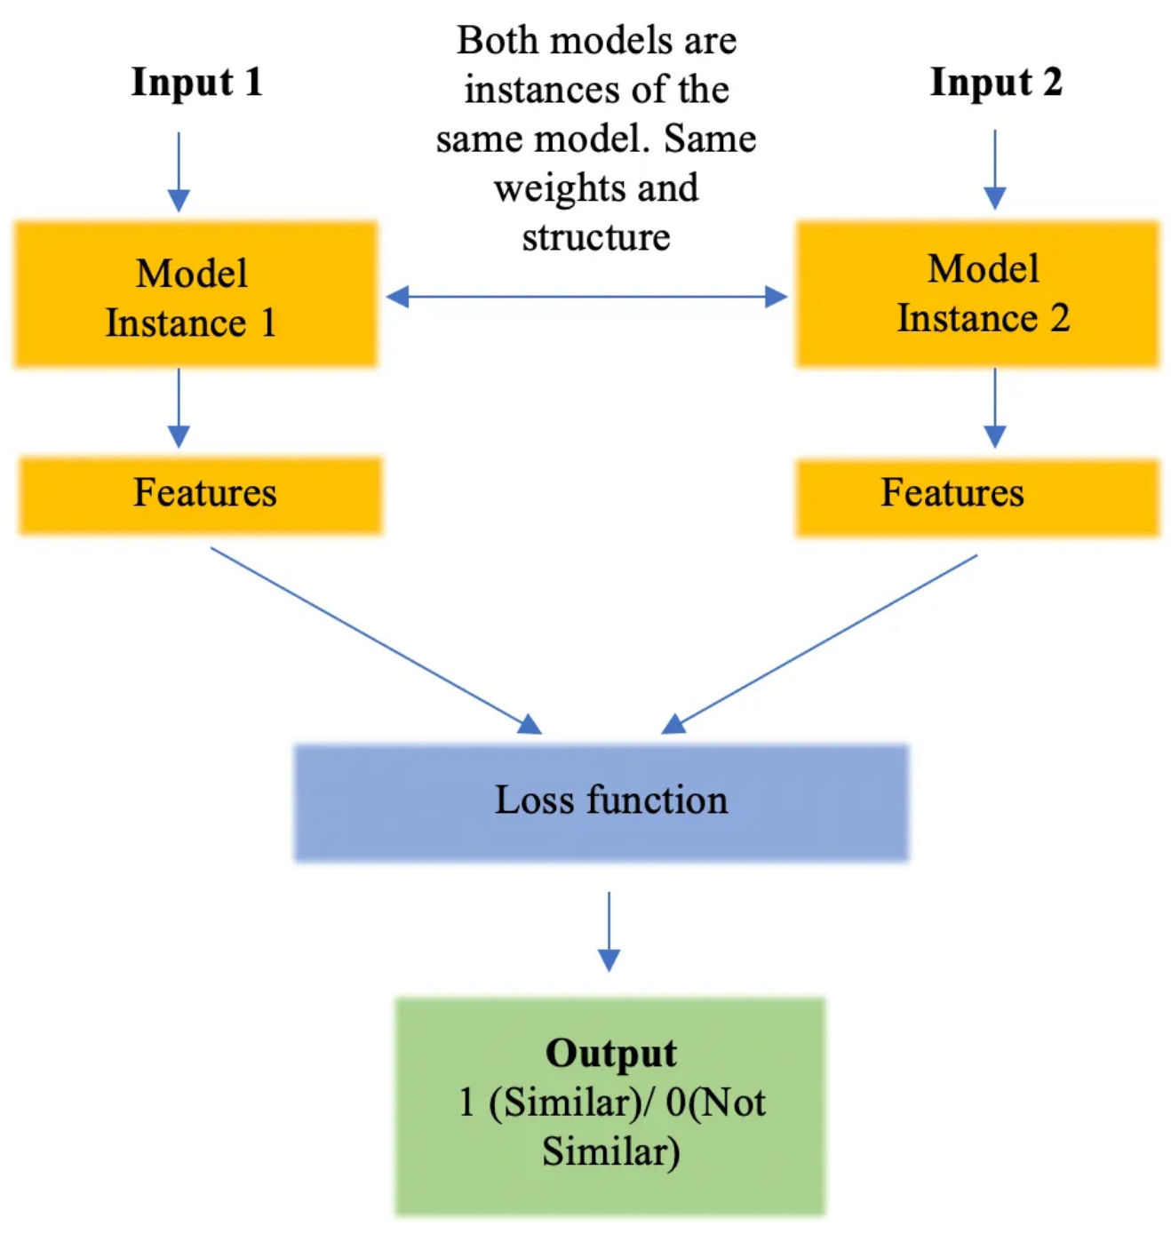
CNN Architectures
02
For same class input pairs, target output is 1 and for different classes input pairs, the output is 0.
Remember, both networks have same the parameters and weights. If not, then they are not Siamese.

Slide 5
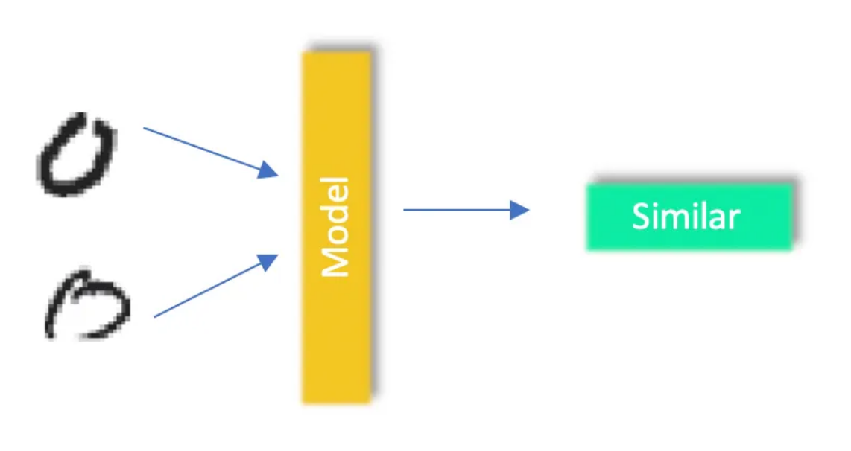
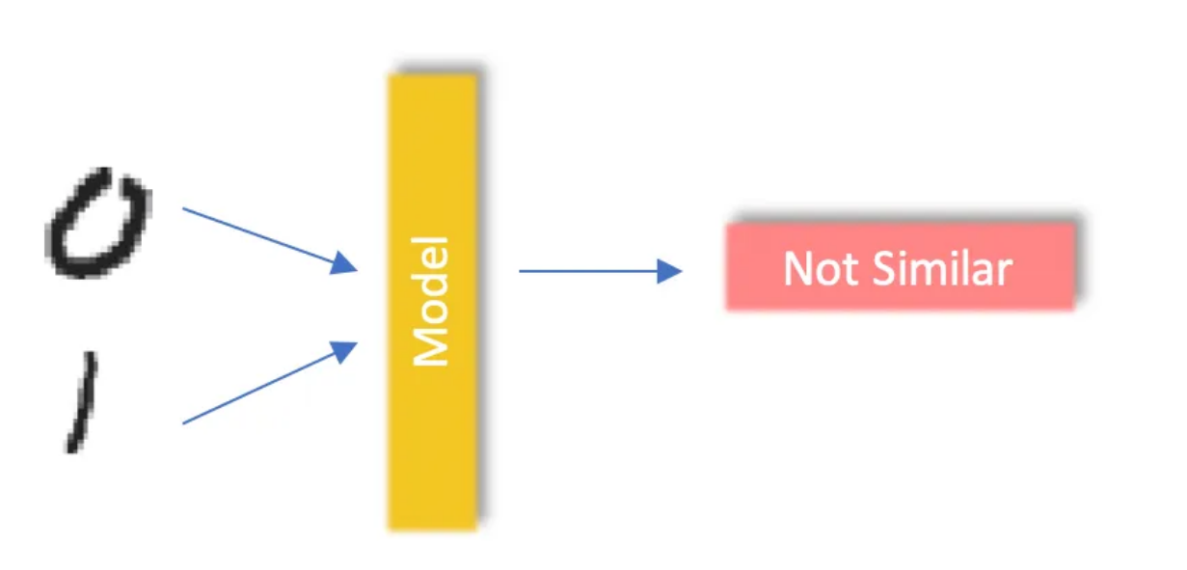
CNN Architectures
02
By doing this, we have converted the classification problem to a similarity problem. We are training the network to minimize the distance between samples of the same class and increasing the inter-class distance.
In siamese, pairs of images are taken. For same class pairs, distance is less between them. For different pairs, distance is more. The distance metric does a good job differentiating between image pairs.

Slide 6
Let’s code together

Slide 7
Assignment 4

Slide 8
Assignment 3
06
Send the screenshots of today’s task in the individual group
Deadline: On or before Wedesday Class (30/06/2023)

